Slide 1



Housing and Support to POCs of the
LGBTQIA+ Community
MIS 6017547 Programme «Αttica 2021-2027»

Slide 2


Key Challenges in Greece
Social stigma and discrimination
Mental health struggles
Hate crimes and violence
Social rejection and lack of inclusive education
Legal gaps and bureaucratic barriers
Healthcare discrimination
Lack of safe housing
Economic and employment vulnerability

Slide 3



Project’s Mission and Results
Social and Employment (Re)Inclusion
Strengthening social cohesion and inclusion
Emancipation of the Individual
Combating Social Exclusion
Safe Semi-Independent living house

Slide 4
Service Flow
Support Helpline 11030 | Psychosocial Support Unit | Semi-Independent Living Housing Unit
A confidential, easily accessible entry point into the programme offering: Psychological and psychosocial support Anonymous information, referrals, and guidance A safe space to report violence or discrimination based on gender identity or sexual orientation Available for POCs of the LGBTQIA+ community, family members and persons who seek information | Emotional and psychosocial support Helps people navigate public services and access their legal rights Supports networking with other social and legal service providers Supports beneficiaries in the process of gaining access to the services of the Semi-independent Housing Unit or other better fitting alternatives | Short-term housing and tailored support to LGBTQIA+ adults (18+) who are: Homeless or at risk Living in unsafe/inadequate housing Key focus areas: Safety, stability, psychosocial support Healthcare, access to legal aid, vocational training Sustainable paths to employment and autonomy

Slide 5
Key Results 4/2026
Support Helpline 11030 | Psychosocial Support Unit | Semi-Independent Living Housing Unit
22 individuals connected to NOSTOS’ employment services
15 individuals matched to job offers
11 individuals got hired
200+ Helpline interactions | 90+ POCs 400+ psychosocial sessions | 24 Individuals provided with housing
Connection to NOSTOS’ employment services

Slide 6
Interesting facts
The uniqueness of the Project relies to:
  NOSTOS’ 30 years of experience in social services based on community needs
  Integrated support model: Safe Housing combined with psychosocial and legal support towards independence.
  Cultural and institutional support: Promoting access to inclusive healthcare, including mental health services.
  Awareness-building: Conducting workshops awareness raising for the community and employers
  Ongoing support: Follow-up care after residents exit the programme to help sustain independence.
  Inclusive reach out.

Slide 7
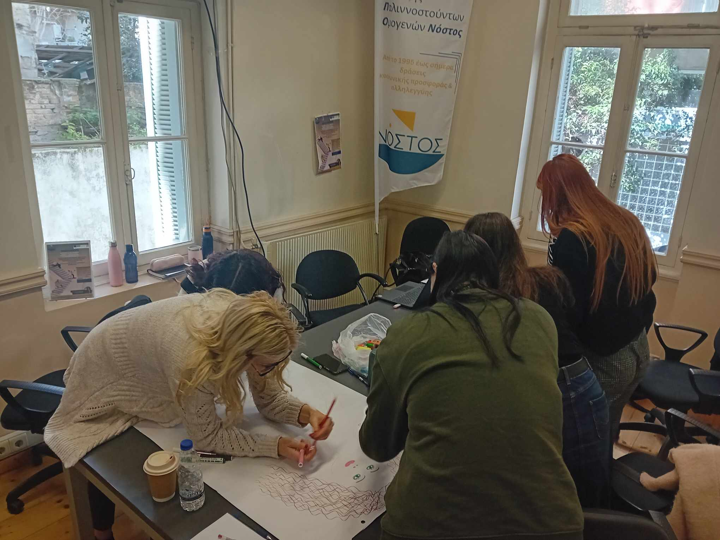
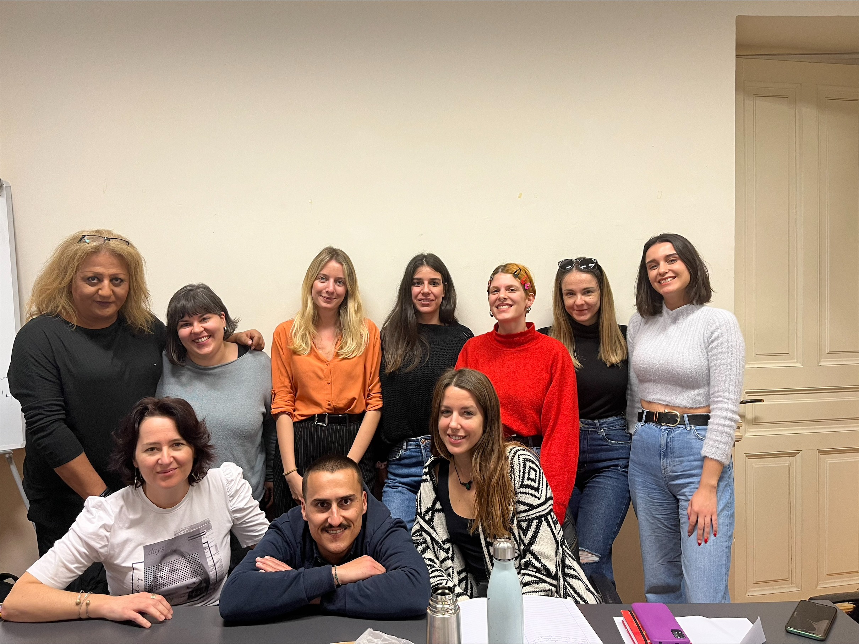
Key People
NOSTOS’ team consists of professionals with experience in the field of the LGBTQI+ community.
Team building was strengthened through a series of structured activities and interactive workshops, enhancing collaboration, communication and team cohesion.

Slide 8
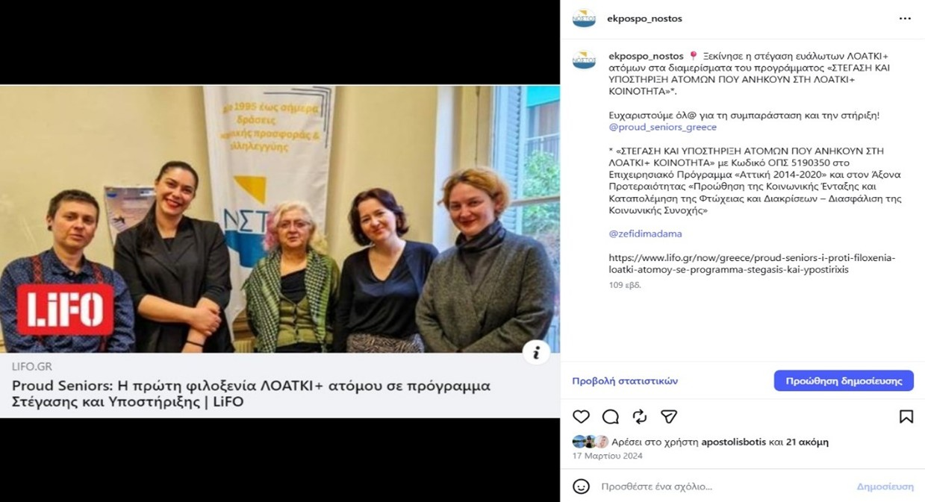
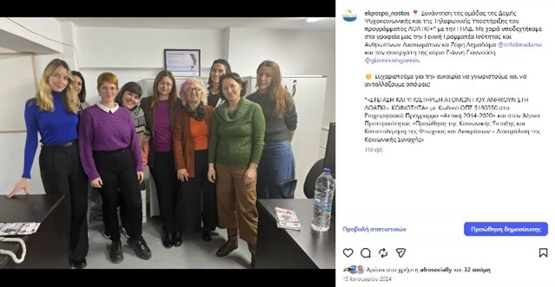
Publicity & Collaborations
Individuals can be informed for the project via NOSTOS’ website ΣΤΕΓΑΣΗ ΚΑΙ ΥΠΟΣΤΗΡΙΞΗ ΑΤΟΜΩΝ ΠΟΥ ΑΝΗΚΟΥΝ ΣΤΗ ΛΟΑΤΚΙ + ΚΟΙΝΟΤΗΤΑ - ΕΚΠΟΣΠΟ Νόστος
and Projects website ΣΤΕΓΑΣΗ ΚΑΙ ΥΠΟΣΤΗΡΙΞΗ ΑΤΟΜΩΝ ΠΟΥ ΑΝΗΚΟΥΝ ΣΤΗ ΛΟΑΤΚΙ + ΚΟΙΝΟΤΗΤΑ - ΕΚΠΟΣΠΟ Νόστος
The project’s visibility was initiated through strategic collaborations and targeted outreach actions, including media coverage (LIFO – Proud Seniors) and engagement with key institutional stakeholders (Municipalities, Ministry of Social Cohesion and Family etc.)

Slide 9
Networking, Awareness Raising
Throughout the duration of the project, systematic networking and information meetings are held with Community Centers, Day Centers, Social Services of hospitals and municipalities, Citizen Service Centres (KEP), municipal authorities in the Attica Region, public services, IEK- vocational institutes, universities and student counselling/support offices in higher education, Second Chance Schools, as well as LGBTQI+ community groups and organizations.

Slide 10
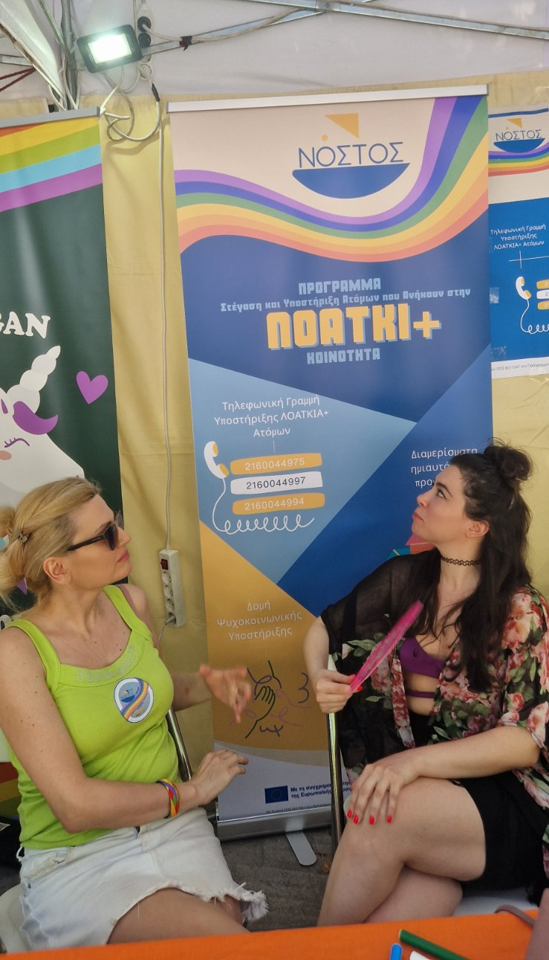
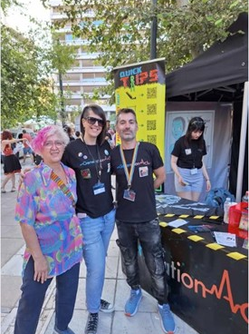

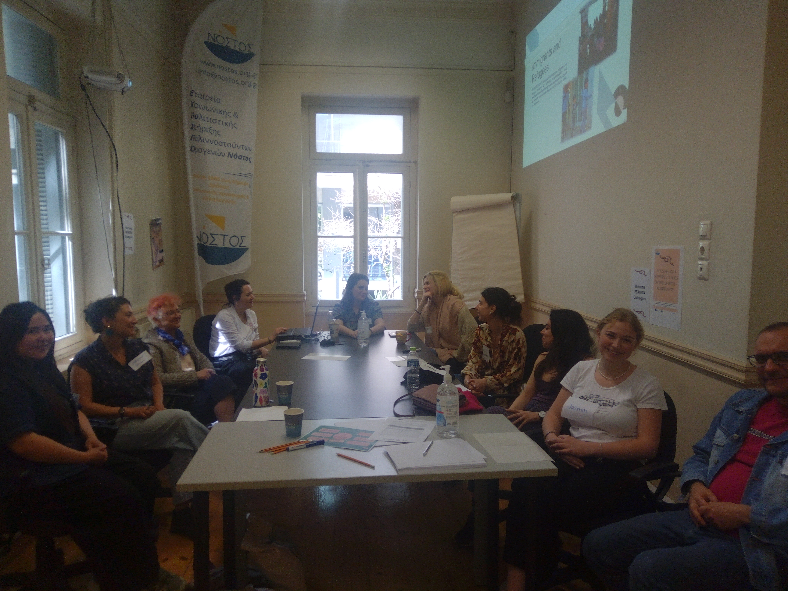
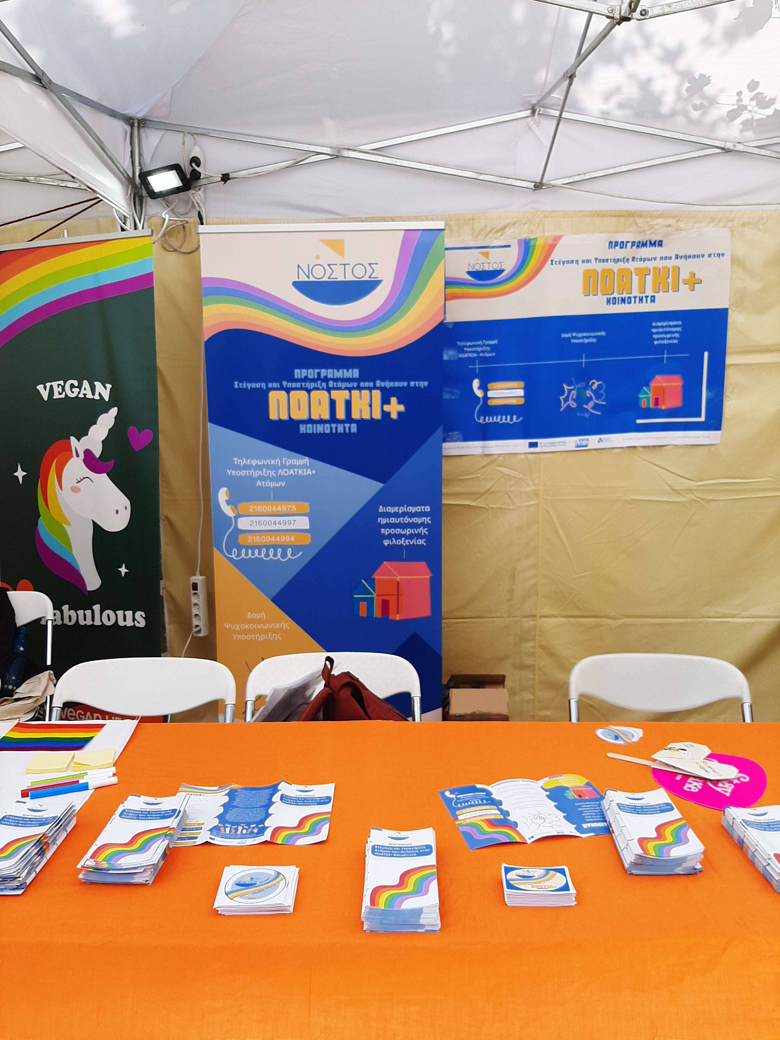
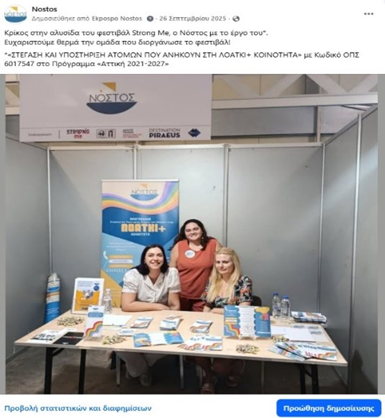
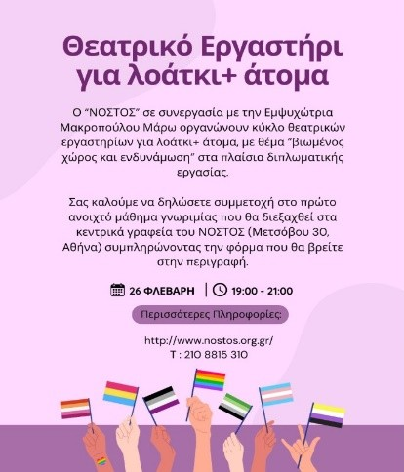
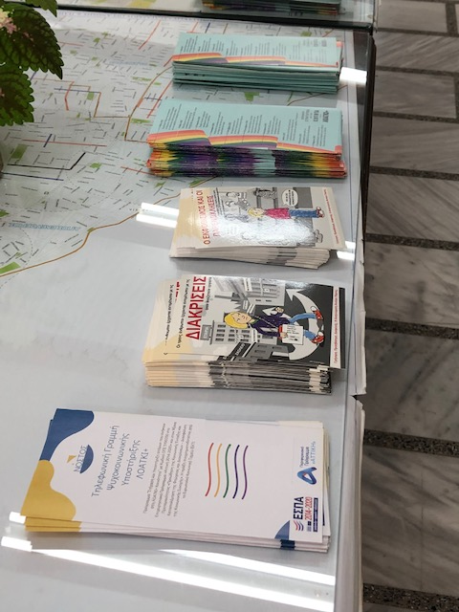
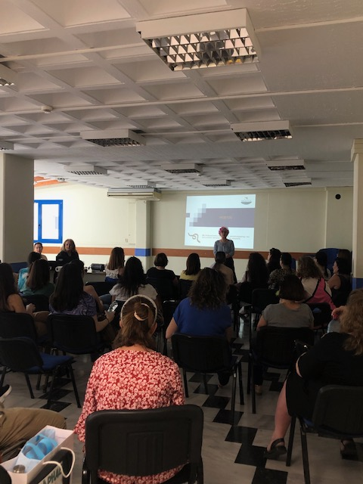
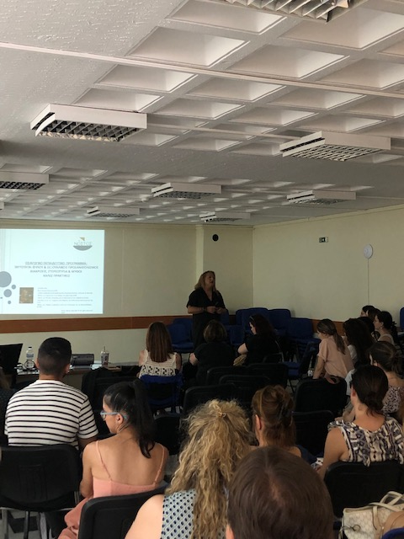
Most Memorable Moments
Athens Pride Festival 2024 & 2025
FEANTSA Pan-European Conference – FEANTSA FORUM in Athens
Training Workshop of the Athens Municipal Clinics:
“Terminology, Gender Identity & Sexual Orientation, Stereotypes and Myths & Good Practices”
Strong me Festival 2025 “This is Athens – City Festival”
Theatre workshop for LGBTQI+ persons

Slide 11
Motivational Beneficiaries’ Quotes
INCLUSION
MEANS
MEETING
PEOPLE
WHERE
THEY
ARE
AND
MOVING
FORWARD
TOGETHER
“Thank you for not judging me throughout our entire collaboration and for supporting me whenever I felt anxious and stressed, which has enabled me to now be in a position to move abroad.”
”I entered this programme dependent, and I am leaving independent.”
“Thank you, thank you very much. I need this home, and I truly appreciate the care and support from the whole team.”
“Thank you all for your support. I truly appreciate that you never judged me”

Slide 12
Links Mentioned
Facebook: Strong me
Facebook: FEANTSA
Facebook: Θεατρικό Εργαστήριο 2
Facebook: Θεατρικό Εργαστήριο 1
Facebook: Pride Parade
Facebook: Εργαστήριο Ευαισθητοποίησης 2
Facebook: Εργαστήριο Ευαισθητοποίησης 1
Facebook: Ύπατος Αρμοστής κατά της ομοφοβίας
Facebook: ΚΕΠ Δήμου Αθηναίων
Facebook: LIFO
Facebook: Συνάντηση με ΓΓ
Instagram: Strong me
Instagram: FEANTSA
Instagram: Θεατρικό Εργαστήριο
Instagram: Pride Parade
Instagram: Εργαστήριο Ευαισθητοποίησης
Instagram: ΚΕΠ Δήμου Αθηναίων
Instagram: LIFO
Instagram: Συνάντηση με ΓΓ

